Slide 1

DriverPass System Analysis
Jonathan Thomas
Notes:
[No speaker notes required for this slide.]

Slide 2

System Requirements
Two Functional Requirements:
The system will allow users to view their progress which is automatically tracked by the system.
User’s will access the system via role-based access control.
Two Non-functional Requirements:
Adequate test-cases must be created to ensure no fatal bugs are pushed to production.
The system infrastructure is cloud-based and should be accessible via the web.
Notes:
When a Customer completes a learning activity on the DriverPass system, this progress is automatically sent to a database that aids in tracking user activity.
To access the system at all, each user must enter valid credentials and then, what each user is allowed to do on the system is determined by role-based access control, a method for separating different types of users.
Rigorous testing ensures that no pesky code bugs make it to the final version of the system.
Cloud-based infrastructure means that all users can access the DriverPass system any place, any time, so long as they are connected to the internet.

Slide 3
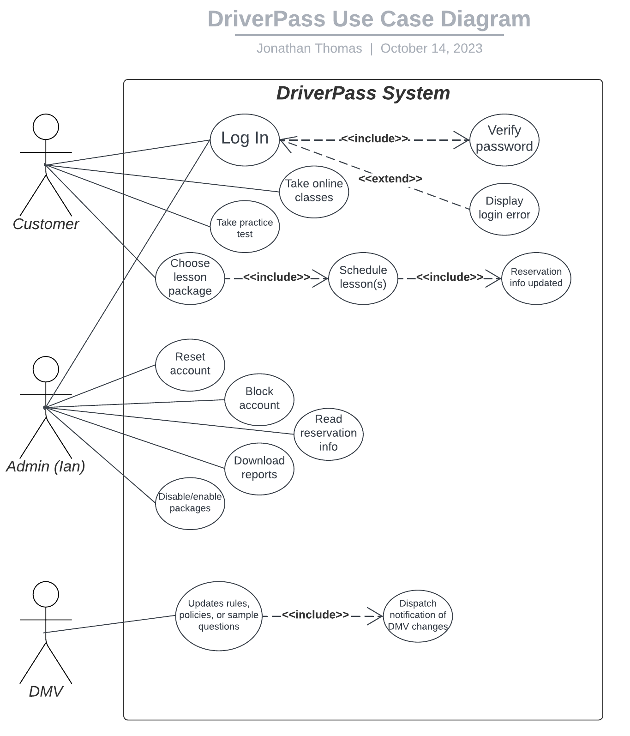
Use Case Diagram
Notes:
There are three primary “users” that can perform actions within the DriverPass system.
Customers, the most common type of user have the capability to log in to the system given they provide valid credentials, take online courses, take practice tests, and choose lesson packages for which they can schedule lessons ahead of time, all online.
Administrators, specifically, Ian, the owner of DriverPass have the capability to reset or block accounts, read reservation information for customer appointments, download user reports that detail system usage, and disable or enable various lesson packages.
Finally, the DMV, while not an actual “user” of the DriverPass system will automatically send a notification to the appropriate DriverPass personnel when changes are made to rules, policies or sample test questions. This helps DriverPass remain up to date on the latest information from the DMV.

Slide 4
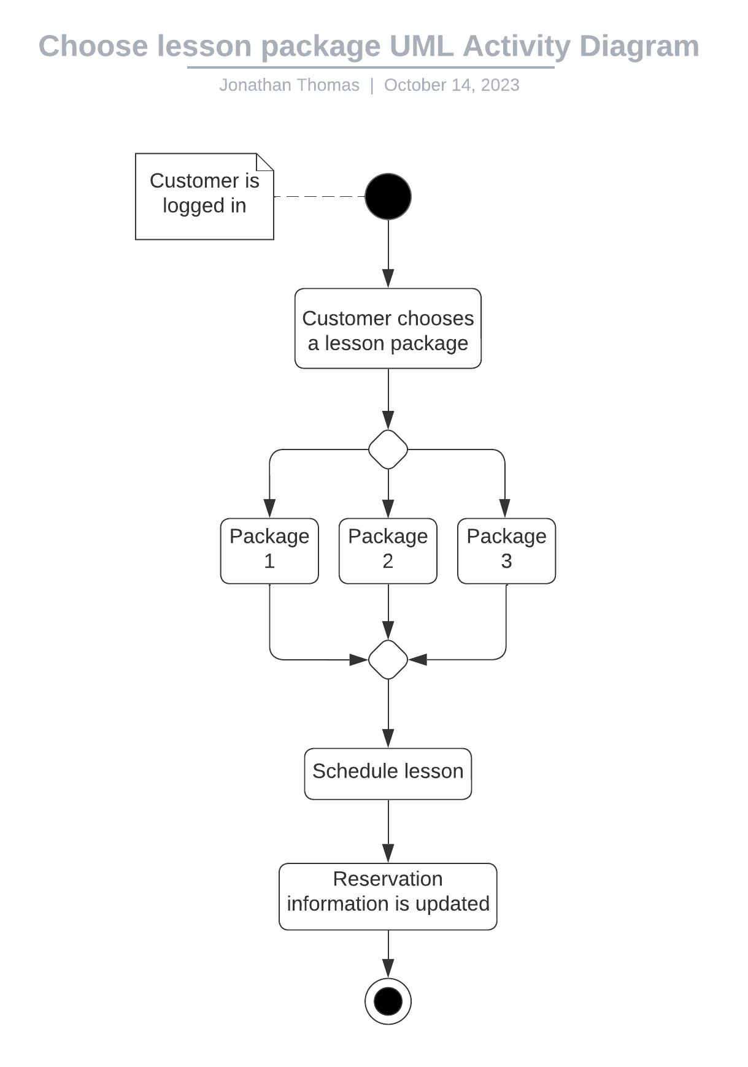
Activity Diagram
Notes:
Starting at the top of the diagram with the solid black circle, we start with the assumption that the user choosing a lesson package is already logged in to the DriverPass system.
Moving down, the Customer can currently choose between three driving lesson packages, each with a unique amount of instruction hours split amongst many days.
Once the Customer has selected their desired lesson package, they will be prompted to schedule a minimum of one lesson, though they can schedule as many lessons as they have paid for.
Finally, one the Customer schedules their lesson(s) reservation information is automatically assigned to their user profile and updated within the DriverPass system.

Slide 5
Security
To access the system, all users must provide valid credentials which are verified by the DriverPass servers
Users are distinguished using role-based access control
All data that traverses the client-server pipeline is secured using RSA encryption
Notes:
At DriverPass, security and user privacy is of the utmost importance.
This is why all users must provide verified credentials to access the system. These credentials are either provided by DriverPass staff or created by users when they sign up for DriverPass services.
Depending on what type of user a certain individual is, they will have different capabilities when they access the system. For instance, only Administrators can reset accounts if a user loses/forgets their password.
All data that passes through the DriverPass system is encrypted using industry-standard algorithms ensuring that all user data is protected from the moment it leaves the user’s computer, to the moment it arrives at DriverPass servers.

Slide 6
System Limitations
To access real-time data, users must have internet access
Users must possess a minute amount of technical ability to locate and access the system
Notes:
Due to the nature of the cloud, if a customer wishes to access the most up to date information regarding their progress or if an administrator wishes to access real time data reports, they must have access to the internet. If not, the data being accessed may be out of date with no guarantee of accuracy.
We at DriverPass are aware that not everyone who may benefit from our system will posses the technical prowess needed to access the internet and then locate our website. While we strive to make this process as easy as possible, there is still a minute amount of technical knowledge needed to access the DriverPass system.

